Slide 1


Library Management System
Team 5
11/02/2023
© 2018 QuEST Global Services Pte Ltd. The information in this document is the property of QuEST Global Services Pte Ltd. and may not be copied or communicated to a third party or used for any purpose other than that for which it is supplied without the written consent of QuEST Global Services Pte Ltd.
1 | © 2018 QuEST Global Services Pte Ltd. Confidential

Slide 2

Coverage
Overview of the project
Requirement & GUIs
High Level Design
Individual contribution
Challenges faced & how it addressed
Experience gained

Slide 3

Overview
The Library Management System is a software application designed to manage a library's collection of books, keep track of the borrowing and return of books, and provide a convenient platform for both library staff and users. The system includes two main components: a librarian staff component and a user component.

Slide 4

High Level Design
The high-level design of the Library Management System involves creating two main components: an Entity class that stores information about library items and a Repository class that handles storage and retrieval of Entity objects. The Repository class is responsible for basic CRUD (Create, Read, Update, Delete) operations, while the Entity class stores information such as the title, author, ISBN, and availability of a book. The system also includes a User class and a Librarian class, which handle the interactions between the user and the librarian staff.
4 | © 2018 QuEST Global Services Pte Ltd.
Confidential

Slide 5

Requirement & GUIs
The requirements for the Library Management System include a user-friendly interface for users to search for and borrow books, as well as a separate interface for librarian staff to manage the library's collection and track borrowing activity. The user interface should allow users to search for books by title, author, and ISBN, and provide information on the availability of a book. The librarian interface should provide tools for adding and removing books, updating book information, and viewing borrowing activity.

Slide 6

Sample Code Snippets
@Autowired
private BookService bookservice;
@GetMapping("")
public String listAllbooks(Model model)
{
List<Book> books = bookservice.findAll();
model.addAttribute("books",books);
return "Book";
}
@GetMapping("add")
public String showBooks()
{
return "/book";
}
@GetMapping("Manage-Books")
public String CheckBooks(Model model)
{
List<Book> books = bookservice.findAll();
model.addAttribute("books",books);
return "Manage-Books";
}
@GetMapping("update/{id}")
public String showUpdateBooks(@PathVariable Integer id,Model model)
{
Book book = null;
Optional<Book> optionalbook = bookservice.findbyid(id);
if(optionalbook.isPresent())
{
book = optionalbook.get();
}
else
{
return "redirect:/error/No Book With ID : "+id+" Found";
}
model.addAttribute("book",book);
return "Update-Book";
}

Slide 7
Sample Code Snippets
@Controller
public class PaymentController {
@Autowired
private UserRepositories repo;
@GetMapping("/showpurchasebooks")
public String ShowBooksPage() {
return "viewall";
}
@GetMapping("/buybooks")
public String ShowPaymentPage() {
return "buybooks";
}
@PostMapping("/userdetails")
public String adduser(@ModelAttribute User user) {
repo.save(user);
return "confirm";
}
}

Slide 8
Sample Code Snippets
@PutMapping("/admin/approve/{id}")
public ResponseEntity<String> approveUser(@PathVariable Integer id) {
Optional<User> user = userrepo.findById(id);
if (user == null) {
return new ResponseEntity<>("User not found", HttpStatus.NOT_FOUND);
}
user.ifPresent(u -> u.setApporved(true));
user.ifPresent(u -> userrepo.save(u));
return new ResponseEntity<>("User approved successfully", HttpStatus.OK);
}
@PutMapping("/admin/issuebook/{userId}/{bookId}")
public ResponseEntity<String> issueBook(@PathVariable("userId") Integer userId,
@PathVariable("bookId") Integer bookId) {
Optional<User> user = userrepo.findById(userId);
Optional<Book> book = bookrepo.findById(bookId);
if (user == null) {
return new ResponseEntity<>("User not found", HttpStatus.NOT_FOUND);
} else {
if (book == null) {
return new ResponseEntity<>("Book not found", HttpStatus.NOT_FOUND);
}
List<Integer> issued = user.get().getBooksIssued()==null?new ArrayList<Integer>():user.get().getBooksIssued();
issued.add(bookId);
user.get().setBooksIssued(issued);
}
user.ifPresent(u -> userrepo.save(u));
return new ResponseEntity<>("Book issued successfully", HttpStatus.OK);
}

Slide 9
Sample Code Snippets
@GetMapping("add")
public String showUsers() {
return "/";
}@GetMapping("update/{id}")
public String showUpdateUsers(@PathVariable Integer id, Model model) {
User user = null;
Optional<User> optionaluser = this.userservice.findById(id);
if (optionaluser.isPresent()) {
user = optionaluser.get();
} else {
@Controller
public class UserController {
@Autowired
private Userservice userservice;
@GetMapping("/{id}")
public String listAllusers(@PathVariable("id") Integer id, Model model) {
List<User> users = userservice.findall();
model.addAttribute("users", users);
return "User";
}

Slide 10

Individual contribution
Abhishek Ghasane
In this project, my role was to design and implement the Entity and Repository classes, as well as the Book and Admin classes. I worked closely with the rest of the team to ensure that the system met all of the requirements and was easy to use for both users and Admin staff.

Slide 11
Individual contribution
2. Ajay kattimani
In this project, I worked on the payment module of the library books and
designed the payment pages for the user, which accepts the user details
And stores the payment history in the database.

Slide 12
Individual contribution
3 Chaithanya N
In this project, my role was to design and implement an Admin Part.
I have implemented functions they are issue book and approve user and displays the payment list of book.

Slide 13
Individual contribution
4. Vaishnavi
In this project,my role was to design and Implement User part.
I have implemented functions they are Searching for books,Borrowing books,Viewing account information,Updating account information.

Slide 14

Challenges faced & how it addressed
Challenge 1: Efficient handling of large amounts of data
Solution: Implemented efficient data structures and optimized code for performance.
Challenge 2: Intuitive and user-friendly user interface
Solution: Conducted user testing and received feedback to improve the interface.
‹#› | © 2018 QuEST Global Services Pte Ltd.

Slide 15

Experience gained
Working on the Library Management System was a great experience, as it allowed me to apply my knowledge of software design and development in a real-world setting. I gained valuable experience in working as part of a team and communicating with others to ensure the project was completed successfully. I also gained experience in optimizing code for performance and addressing user feedback to improve the user experience. Overall, this project was a great opportunity for me to grow as a software developer.
‹#› | © 2018 QuEST Global Services Pte Ltd.

Slide 16
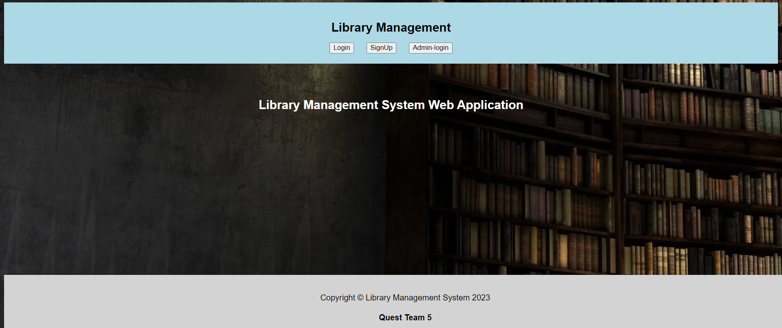
Demo
‹#› | © 2018 QuEST Global Services Pte Ltd.

Slide 17
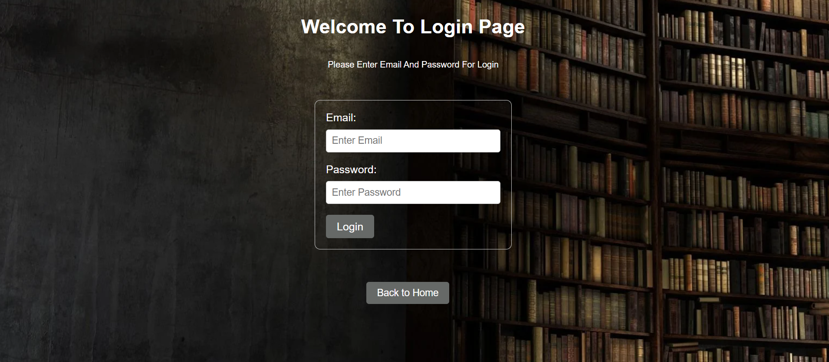
Demo
‹#› | © 2018 QuEST Global Services Pte Ltd.

Slide 18
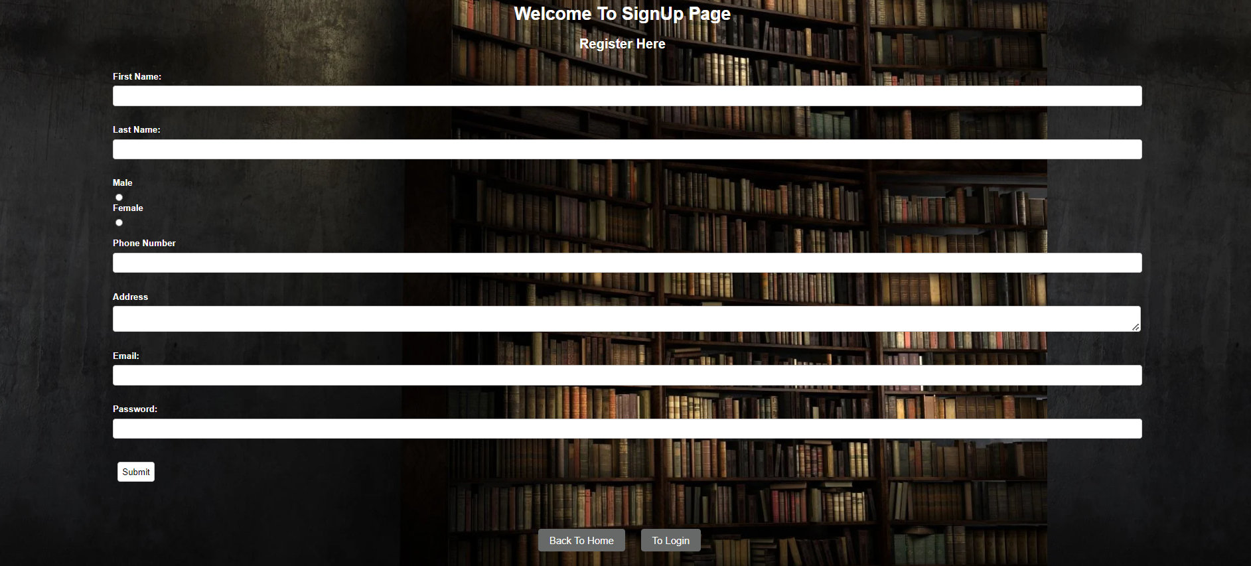
Demo
‹#› | © 2018 QuEST Global Services Pte Ltd.

Slide 19

Demo
‹#› | © 2018 QuEST Global Services Pte Ltd.

Slide 20
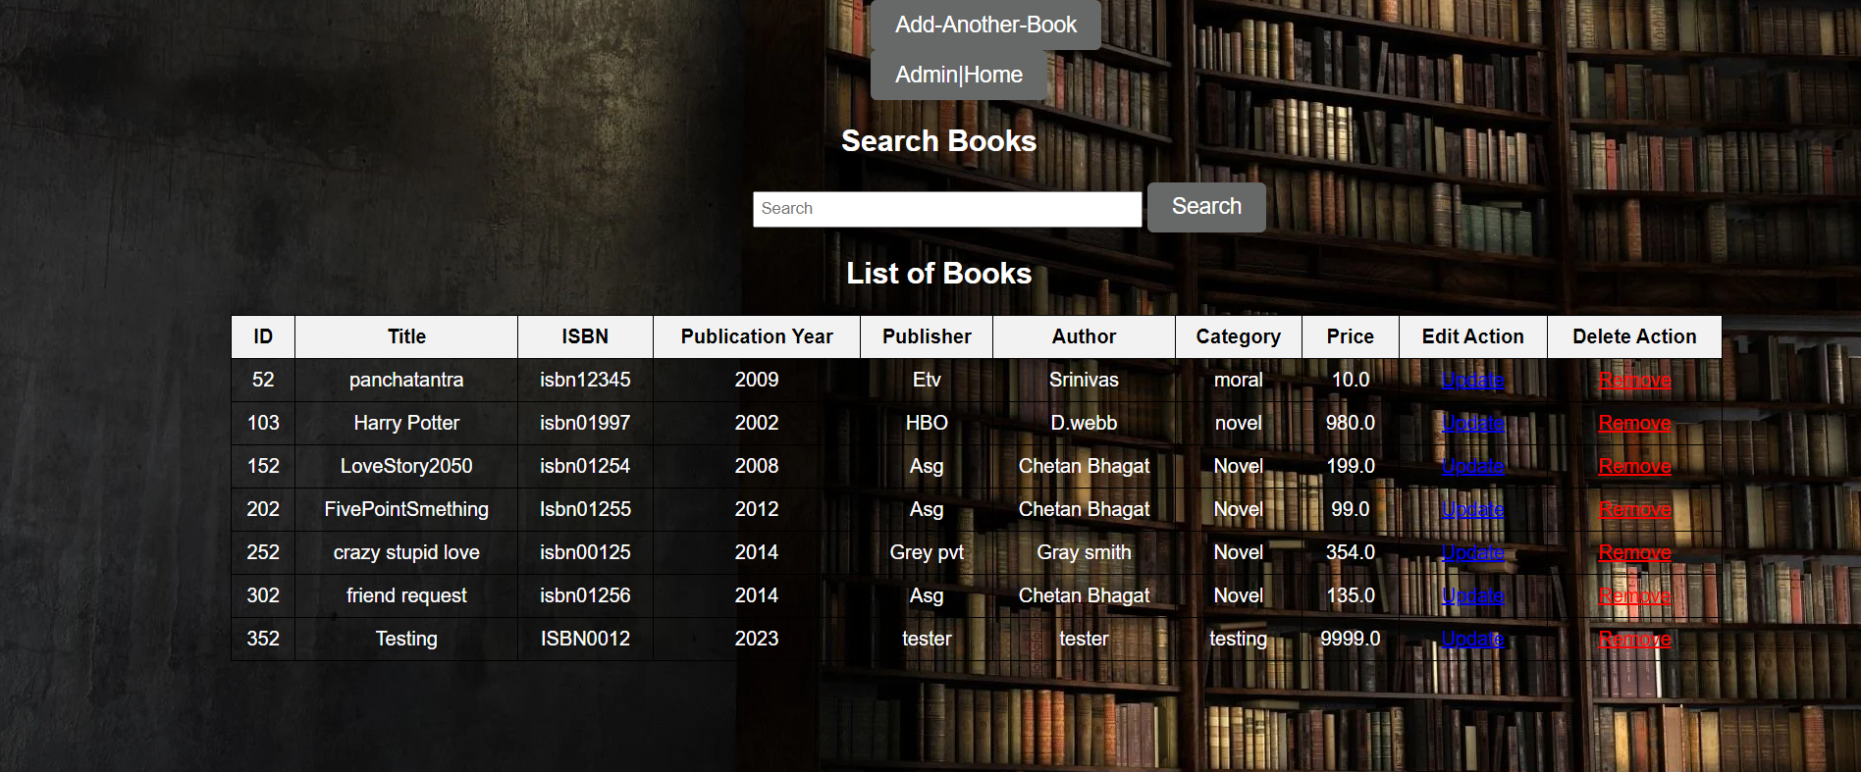
Demo
‹#› | © 2018 QuEST Global Services Pte Ltd.

Slide 21

Demo
‹#› | © 2018 QuEST Global Services Pte Ltd.

Slide 22




Thank You
© 2018 QuEST Global Services Pte Ltd. The information in this document is the property of QuEST Global Services Pte Ltd. and may not be copied or communicated to a third party or used for any purpose other than that for which it is supplied without the written consent of QuEST Global Services Pte Ltd.
13 | © 2018 QuEST Global Services Pte Ltd. Confidential

